Slide 1
Systems Architecture
A practical approach

Slide 2
Traditional Approach
  Requirements & theory - weeks
  Architecture & theory – weeks
  Doing something – after
Notes:
i.e. Traditional approach is spend weeks on requirements & theory of requirements; then spend weeks on arch and arch theory. We will take a more hands on approach

Slide 3
Our Approach
  Weave architecture & requirements
  Start with architecture & architectural concepts
  Requirements (relating to what learnt on architecture)
  Goals
    Connect requirements and architecture
    More real-world approach
      Start architecturing during requirements discussion
      Ask for requirement clarifications based on architecturing
    Understanding of system components / layers
      Critically important for successful system design
    Hands-on activities on architecture shaping
    Plenty of writing
      Reflects architecture shaping process & communications
Notes:
i.e. Traditional approach is spend weeks on requirements & theory of requirements; then spend weeks on arch and arch theory. We will take a more hands on approach

Slide 4

So you think you know software?
But do you understand what you are doing?
Do you understand WHY & HOW your code works?
  Knowing the syntax is not enough
  E.g., how is a recursion executed really?
    tail call optimization – why & when?
  E.g., Java string pool
    when new one is created & when is reused?
Do you understand all the pieces that come together to make it work?
  Physical aspect is important too
    E.g., replication, multi-region setups, CAP theorem, edge servers,..
    Cloud is somebody’s computer
  E.g., auth screen – Auth API, token storage, network routing, encryption, etc

Slide 5
So you think you know software?
Do you understand how changes in one area affect other areas?
  Everything is interconnected
  Change one thing -> ripple effect
    From UI to compiler optimizations
  E.g., need to increase UI responsiveness
    Create DB read-only replicas (new hardware and software)
      Master-Slave vs Master-Master
      Bin log vs transaction log
    Reconfigure DB
    Change network configuration
    Rewrite DAO layer
    Modify business logic

Slide 6
So you think you know software?
Do you understand how the architecture and the software affect the people who use it?
  E.g., cache misconfiguration
    A lot of misses
    Slow page loading speed
    Customers abandon shopping carts
  E.g., scalable architecture
    Additional hardware
    Seamless failover
    Users do not notice server crash
It’s all architecture
Until you understand the architecture, you can’t really build powerful applications with your code.

Slide 7
And what is an architect, anyway?
Architect:
[A] person who plans, designs and oversees the construction of [applications/ systems]
Not just a coder
  decision-maker
  a bridge between stakeholders and engineers
    understand needs
    design a solution
E.g., decides how data flows among
  a mobile app
  web portals
  database
  security, reliability, regulations (e.g., healthcare), maintainability, scalability, available resource

Slide 8
And what is an architect, anyway?
What skills does the [software] architect need?
Computers & OS, Networks, Software
  Memory allocation, thread management, etc
  Network configuration / protocols / security, etc
  Languages, frameworks, libraries, applicability
People, Processes, Business, Law …
  Business understanding
  Requirements negotiations
Communications, Requirements, Analysis, …
  Clear documentation & technical design
Yeah, that’s a lot! Architecture requires you to know a lot about a lot. It is a high skill role
And we will cover many of these topics [not all in depth … you have a lifetime for that!]

Slide 9
Some of the topics
Architecture is multi-disciplinary
  Computer basics
    Some people think of access speed: memory -> local storage -> network
    But in many cases, it’s: memory -> network -> local storage
  OS basics
    OS process management affects web server request handling
    How to choose a thread pool size?.. If don’t know how OS treats threads
  Networking basics
    Why TCP for transactions and UDP for real-time video?
    How does SSL work?
  Data and ML basic
    Relational vs NoSQL? When & why?
    NoSQL for IMDB-like because of hype
  APIs and Services
    REST vs GraphQL vs gRPC – why & when?
  …

Slide 10
Some of the topics
Lot of things
  Not full coverage
  Basic introduction
- Always space to learn

Slide 11
What is Software Architecture
?
The software architecture of a system is the set of structures needed to reason about the system. These structures comprise software elements, relations among them and the properties of both.
Notes:
The software architecture of a system is the set of structures needed to reason about the system. These structures comprise software elements, relations among them and the properties of both.
Architecture is an abstraction – We select and focus on certain details in the system. We do this to manage complexity
Architecture is a set of software structures:
Module Structures – the static design of the system
Component-and-Connector Structures – describe the dynamic aspects of the system
Allocation Structures – how the software maps into non-software entities, think about how a system is built.
Architecture is design, but not all design is architecture – many design decisions are unspecified by the architecture

Slide 12
What is Software Architecture
Hard to catch?
Simpler:
  components
    services, modules, components, etc
  relationships
    data flows, dependencies, interfaces, etc
  properties of both
    situational
More complex than it looks
  multiple levels of abstraction
  to focus on an important aspect right now
  jump between them
Notes:
The software architecture of a system is the set of structures needed to reason about the system. These structures comprise software elements, relations among them and the properties of both.
Architecture is an abstraction – We select and focus on certain details in the system. We do this to manage complexity
Architecture is a set of software structures:
Module Structures – the static design of the system
Component-and-Connector Structures – describe the dynamic aspects of the system
Allocation Structures – how the software maps into non-software entities, think about how a system is built.
Architecture is design, but not all design is architecture – many design decisions are unspecified by the architecture

Slide 13
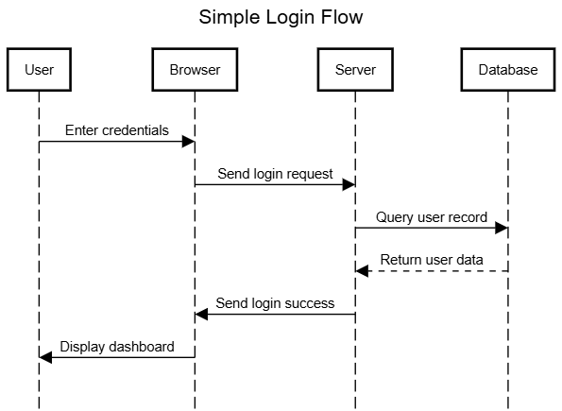
What is Software Architecture
  Software structure types
  Module structures
    How the system is organized (modules or layers)
    Static design
    E.g., UI layer, business logic layer, data access layer
    E.g., auth service, transaction service, message server, etc
  Component-and-Connector structures
    How the component interact
    Dynamic behavior
    E.g., execution flow diagrams, data flow diagrams
      Requests hits a reverse proxy, API gateway, web server, microservices, database
  Allocation structures
    Map software components to non-software ones
    E.g., on which server which service will be running
    E.g., on which cloud service which service will be running (e.g., EC2, EKS, Lambda functions)
Notes:
The software architecture of a system is the set of structures needed to reason about the system. These structures comprise software elements, relations among them and the properties of both.
Architecture is an abstraction – We select and focus on certain details in the system. We do this to manage complexity
Architecture is a set of software structures:
Module Structures – the static design of the system
Component-and-Connector Structures – describe the dynamic aspects of the system
Allocation Structures – how the software maps into non-software entities, think about how a system is built.
Architecture is design, but not all design is architecture – many design decisions are unspecified by the architecture

Slide 14
Business goals VS software goals
  Ride-sharing app
      business / end goal – grow market share by reducing wait time
        in requirements <= business’ responsibility
        cannot give it to engineers
      software goal – implement real-time location tracking & smart matching
        in requirements <= architect’s responsibility
  Architecture is a bridge between end goal & requirements (specify how to achieve)
    Blueprint
    e.g., determines
      event-driven backend for real-time processing
      websockets for real-time updates
      custom geospatial indexing system for algorithms
      CDN for static resources
      etc
Notes:
There is a chain here -> software is needed to achieve an end goal -> requirements specify and clarify that end goal -> an architecture provides the blueprint to get from the requirements to the goal

Slide 15
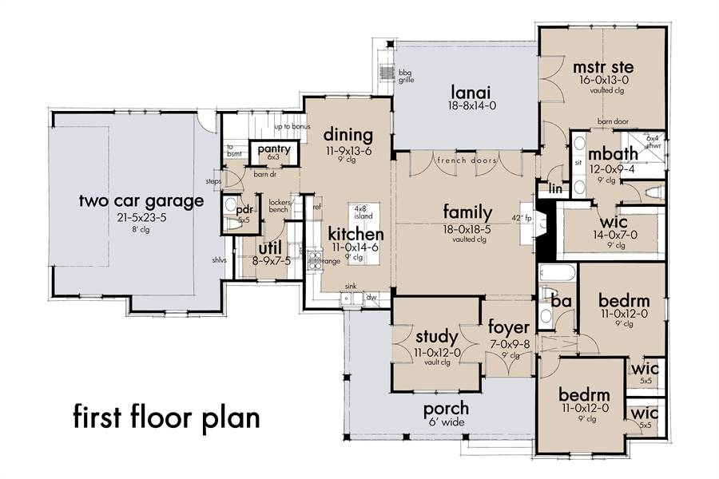
Architecture of a house
When you build a house:
You lay out things like:
Foundation structure
Framework (rooms, doors)
Wiring, plumbing
Then builders follow the instructions
provided by architect
How does the architect know what to tell the builders?
They ask the client (Requirements!)
Similar with Software
https://www.thehousedesigners.com/plan/mill-creek-farm-7844/

Slide 16
Observations
  Every software system has a software architecture
    planned - aligned with the goals
    unplanned – accidental
    both can be bad or good
      but there is a tendency
    e.g., startups can start with ad-hoc architecture
      forced to redesign & rewrite for scaling
        sometimes intentional – show results fast => get funding => redo in a right way
  Every software system affects users and the environment around it
    Direct – UX, privacy, carbon footprint
    Indirect – infra cost, legal compliance
    Determined by its architecture
Notes:
There is a chain here -> software is needed to achieve an end goal -> requirements specify and clarify that end goal -> an architecture provides the blueprint to get from the requirements to the goal

Slide 17
Architecture is an Abstraction
  Abstraction simplifies the view
    too many details
    selects certain details and suppresses others
  Architecture - visible interactions between components
    APIs
    public classes
    not hidden internals
    levels of abstractions -> subcomponents
  Metaphors - good tools for abstracting away complexity
    desktop metaphor – Alto, Viewpoint, MacOS, Windows, Gnome
      hard drive -> FS -> altering a file system-> -> mv [source] [target] -> drag & drop a file
      hide technical complexity

Slide 18
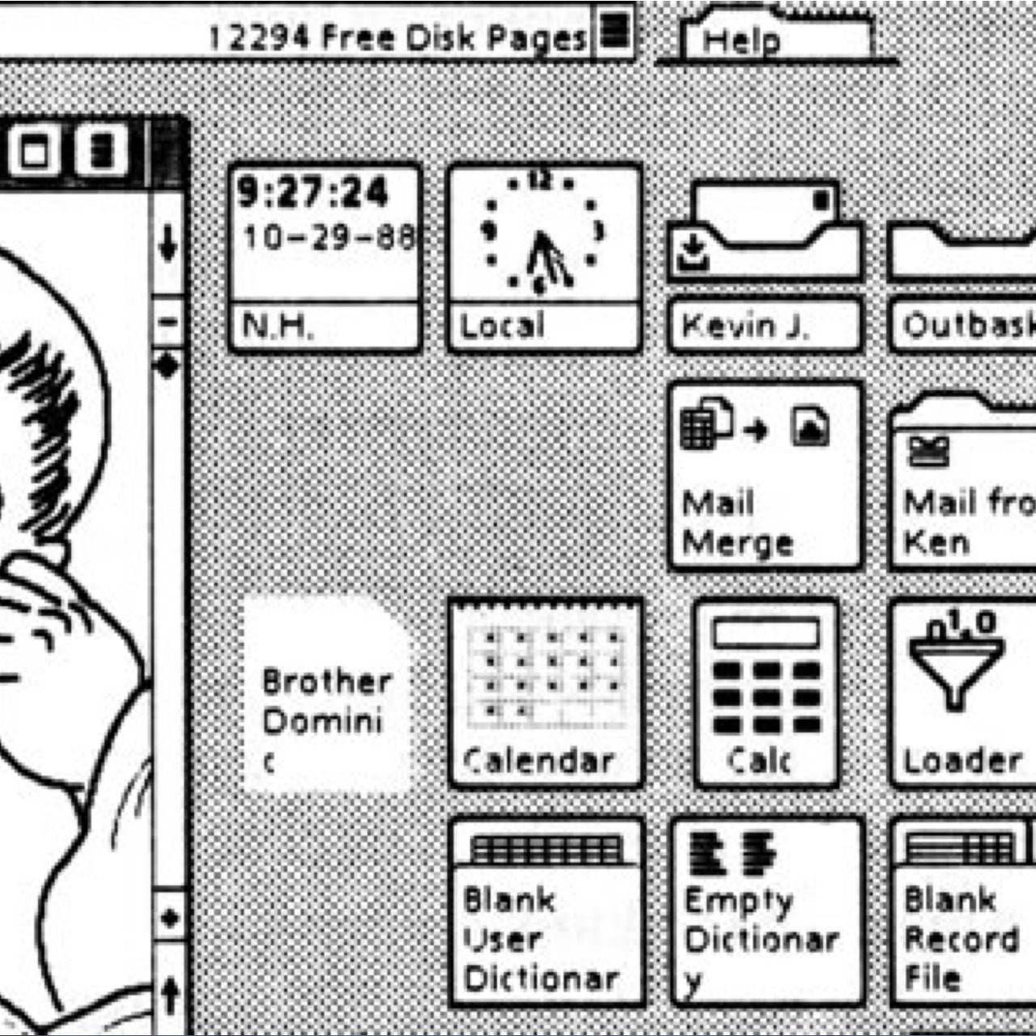
Example
You don’t recognize this desktop metaphor, but
  you can understand eve if
  hidden details are completely different now
  SA metaphors work the same way
  Patterns are an area in software architecture that is rich in metaphors:
  Pipe & Filter
  Blackboard
  Etc.
Notes:
GlobalView - circa 1988 – Before Win

Slide 19
The Benefit of Good Architecture
Increase
Value of reuse
Requirements
Architecture
Design
Code
Cost of defects
Increase
Not just convenience or scalability
The later a fix, the more its cost => save in a long run
The earlier shared elements identified, the less a system costs
  4 message services, 5th in progress

Slide 20
What Makes a “Good” Architecture?
Product (Structural) Guidelines
Well defined functional modules using
  information hiding
    components don’t know how other work
      avoid undocumented functionality => change -> break other components
  separation of concerns
    one component responsible for on task
      avoid entanglement => cannot change w/o external changes
  Encapsulates functionality to allow changes
    Can change a module without breaking something else
  independent concurrent development by separate teams
    Scalable development, no blocking
Technical
Process

Slide 21
What Makes a “Good” Architecture?
Quality attributes
  Use standard architectural patterns and tactics specific to each attribute
  E.g.,
    Scalability -> load balancing, stateless services (why?)
    Security -> zero-trust network, encryption
    Maintainability -> standard coding conventions, layered architecture
Limited vendor lock
  Risks:
    Licensing changes
    Cost raise
    Support end
  Try open standards with multiple implementations
    Not always possible or rational

Slide 22
What Makes a “Good” Architecture?
A well thought-out architecture must consider these important principles:
Build to change instead of build to last
  Modularity
  Loose coupling
  Clear interfaces
  E.g., payment processing – plugin modules for new providers
    strategy pattern
Understand the end user needs and the domain before designing components
  Need to design a ride-sharing app?
    Learn how drivers, dispatchers, riders interact
  Need to design an accounting system?
    Go & talk to accountants
https://www.infovista.com/blog/the-importance-of-software-architecture

Slide 23
What Makes a “Good” Architecture?
A well thought-out architecture must consider these important principles:
Decompose into layers and components & identify the key interfaces
  Separate “ride booking” from “payments”
    Can be another functionality requiring payments
    Abstracting – allows Lego bricks thinking
Incremental and iterative approach to designing the architecture
  Do not design everything upfront
  Requirements will change / become more clear
  Technical limitations will emerge
  Otherwise – wasted time
  e.g., start with a monolith, extract microservices when needed
    Job interview – bank – we want microservices
https://www.infovista.com/blog/the-importance-of-software-architecture

Slide 24
What Makes a “Good” Architecture?
A well thought-out architecture must consider these important principles:
Learn from history, document your decisions and identify and mitigate key risks
  Use previous experience
  Write down why decisions are made (reasons, alternatives, factors, logic)
    Future architects will not need to re-evaluate everything
    Helps engineers to understand the context
Do not under-invest in architecture
  Design something upfront
  Make it flexible / maintainable
  Decrease the development / maintenance cost
What would you change in your past projects? Think after each future project.
https://www.infovista.com/blog/the-importance-of-software-architecture

Slide 25
Architecture is a set of Software Structures
No single structure defines the architecture
There are three broad categories of structures:
  Module Structures – the static design of the system
  Component-and-Connector Structures – describe the dynamic aspects of the system
  Allocation Structures – how the software maps into non-software entities, think about how a system is built.
We will discuss these in detail throughout this course
Notes:
Metaphors – a software architecture is a symphony, you are the conductor and the collection of software elements are the instruments. Your objective is to get them to work together and make beautiful music.

Slide 26
Architecture is about Behavior
Software structures provide the “Lego blocks” of the system.
How do they behave?
  What interactions are there?
    Drivers? Riders? Administrators? Support operators?
      How specifically for each?
    Push-notifications?
    Server API?
  Request-specific behavior?
    All hail use cases & their implementation
  What if smt is wrong?
    E.g., payment gateways is out -> retry 3 times (exponentially?) -> mark “pending payment” -> notify support
    Every possible scenario => happy path is easy, unhappy ones – real complexity
  Understanding, capturing, documenting and ensuring that these ideas are carried forward into the implementation is Software Architecture.

Slide 27
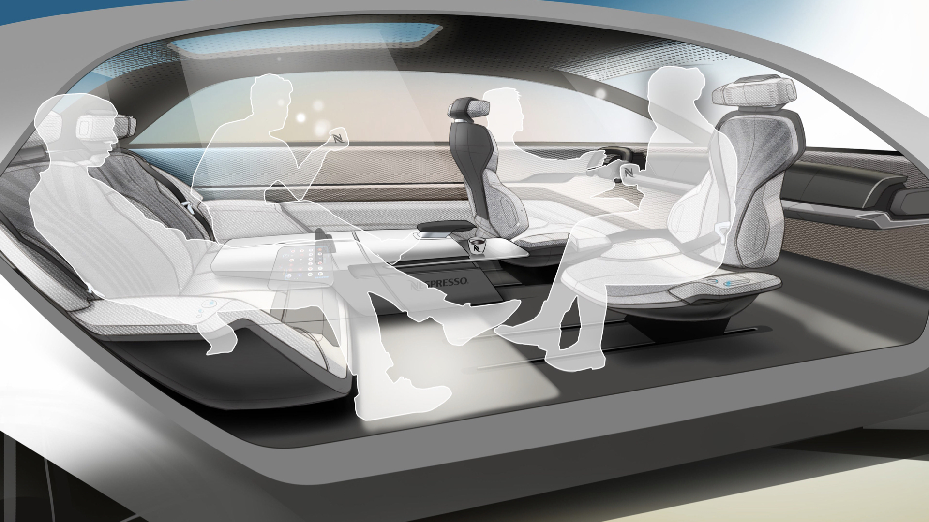
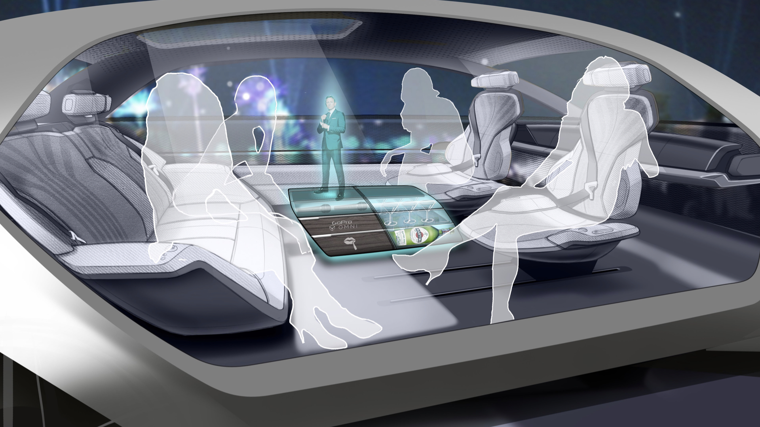
Concept Car – understanding behavior
Design depends on required behavior / functionality
Designing an autonomous car interior for endless possibilities
For Grammer AG, a leading interior component supplier, we defined a vision on how semi-autonomous car interiors might look for the next generation of cars with Level 4 Autonomy.
https://www.granstudio.com/grammer
Notes:
This is about ‘How will people use the thing I am building. If it’s not ‘driver/ passenger’, you would arrange seating differently

Slide 28
What type of requirements matter to Architecture?
Does the architect need every detail?
No, only things that affect the architecture
Examples:
  # of stories;
  # rooms;
  position of house relative to sun;
  local regulations/ ordnances;
  geographic location (hot/ code);
  type of heating;
  open spaces desires
Examples of don’t care: Paint color; trim types; kitchen appliances; …
  They are cometic & interchangeable
Notes:
Use room/ light example here…

Slide 29
What type of requirements matter to Architecture?
Ask yourself:
  Does it affect structural decisions?
  Does it affect system behavior?
    auth vs report background color
  Does it restrict possible technologies?
    Android app -> no Swift
  Is it legal necessity?
Types of requirements:
  User requirements -> allow to reset passwords
  Workflow requirements -> new orders to be routed to this mailbox
  Environment and constraints -> must run on Windows and Linux
… but not every detail
  no, I don’t care about a button color
Notes:
Use room/ light example here…

Slide 30
ASRs
There are Architecturally important needs, and then ‘other’
  ASR = Architecturally Significant Requirements
  Can misclassify ASR
  New ASR can be introduced
  ‘Other’ become ASR
    Dynamic life for dynamic people
    Think what can become ASR in future
Notes:
Watch out for hidden impacts of requirements that will disrupt your architecture assumptions

Slide 31
ASRs
In houses, architects need to understand
  the physics and science behind the decisions
  impacts of their decisions (load, stability, safety, aesthetics, …)
  E.g., wood vs concrete & glass
In software you need the same thing.
Understand
  what is behind all the possibilities for arch. choices and decisions
  implications with each choice
There are Architecturally important needs, and then ‘other’
  ASR = Architecturally Significant Requirements
  PS: Sometimes ‘other’ comes back as architecturally important
  PPS: watch out for unexpected consequences of choices
Notes:
Watch out for hidden impacts of requirements that will disrupt your architecture assumptions

Slide 32
ASRs
  PPS: watch out for unexpected consequences of choices
  E.g.,
    Designed a system for the US
    No way to delete user data
    Business expanded to EU
    Hello, GDPR
    Need to be able delete the data from EVERYWHERE
      databases (dozens+)
      data lakes
      data marts
      logs
      backups
      etc
    Massive system redesign
Notes:
Watch out for hidden impacts of requirements that will disrupt your architecture assumptions

Slide 33
Gall’s law
1975 observation known as Gall’s Law (named for pediatrician and systems design theorist John Gall)
“A complex system that works is invariably found to have evolved from a simple system that worked,”
“A complex system designed from scratch never works and cannot be patched up to make it work. You have to start over with a working simple system.”
Try to build Google from scratch.
No ‘big-bang theory’. Architecture (like everything else in software) is inherently iterative …
John Gall (author) - Wikipedia

Slide 34
Understanding basics
We will build from the ground up – just like a house
In software, what makes an Application? What are the main pieces?
  Computer – executes your code
  Connectors (networks) – communications for your systems
  Components – existing tools
  And then your own software
To be able to architect software, you must first be literate in the basics
  Before you can write a novel, you must learn English, grammar, etc.
  We will give you a (brief) foundation in computer literacy before architecture
To be able to architect, you must be able to analyze and measure!

Slide 35
Discussion Assignment
Software Architecture In Practice (4th ed.)
- How does an architecture serve as a basic for analysis? For decision making … etc.
Notes:
What qualities can be analyzed if we have an architecture? E.g., performance -> layered architecture -> latency -> how to measure & analyze?

